Slide 1
Lab 8: Final Presentation
2/3 Body Problem
C2C Gowri Ramaprasad
C2C Derek Weissinger
C2C Owen Crawley
Notes:
https://www.youtube.com/watch?v=jVXgWGK9Kr8

Slide 2
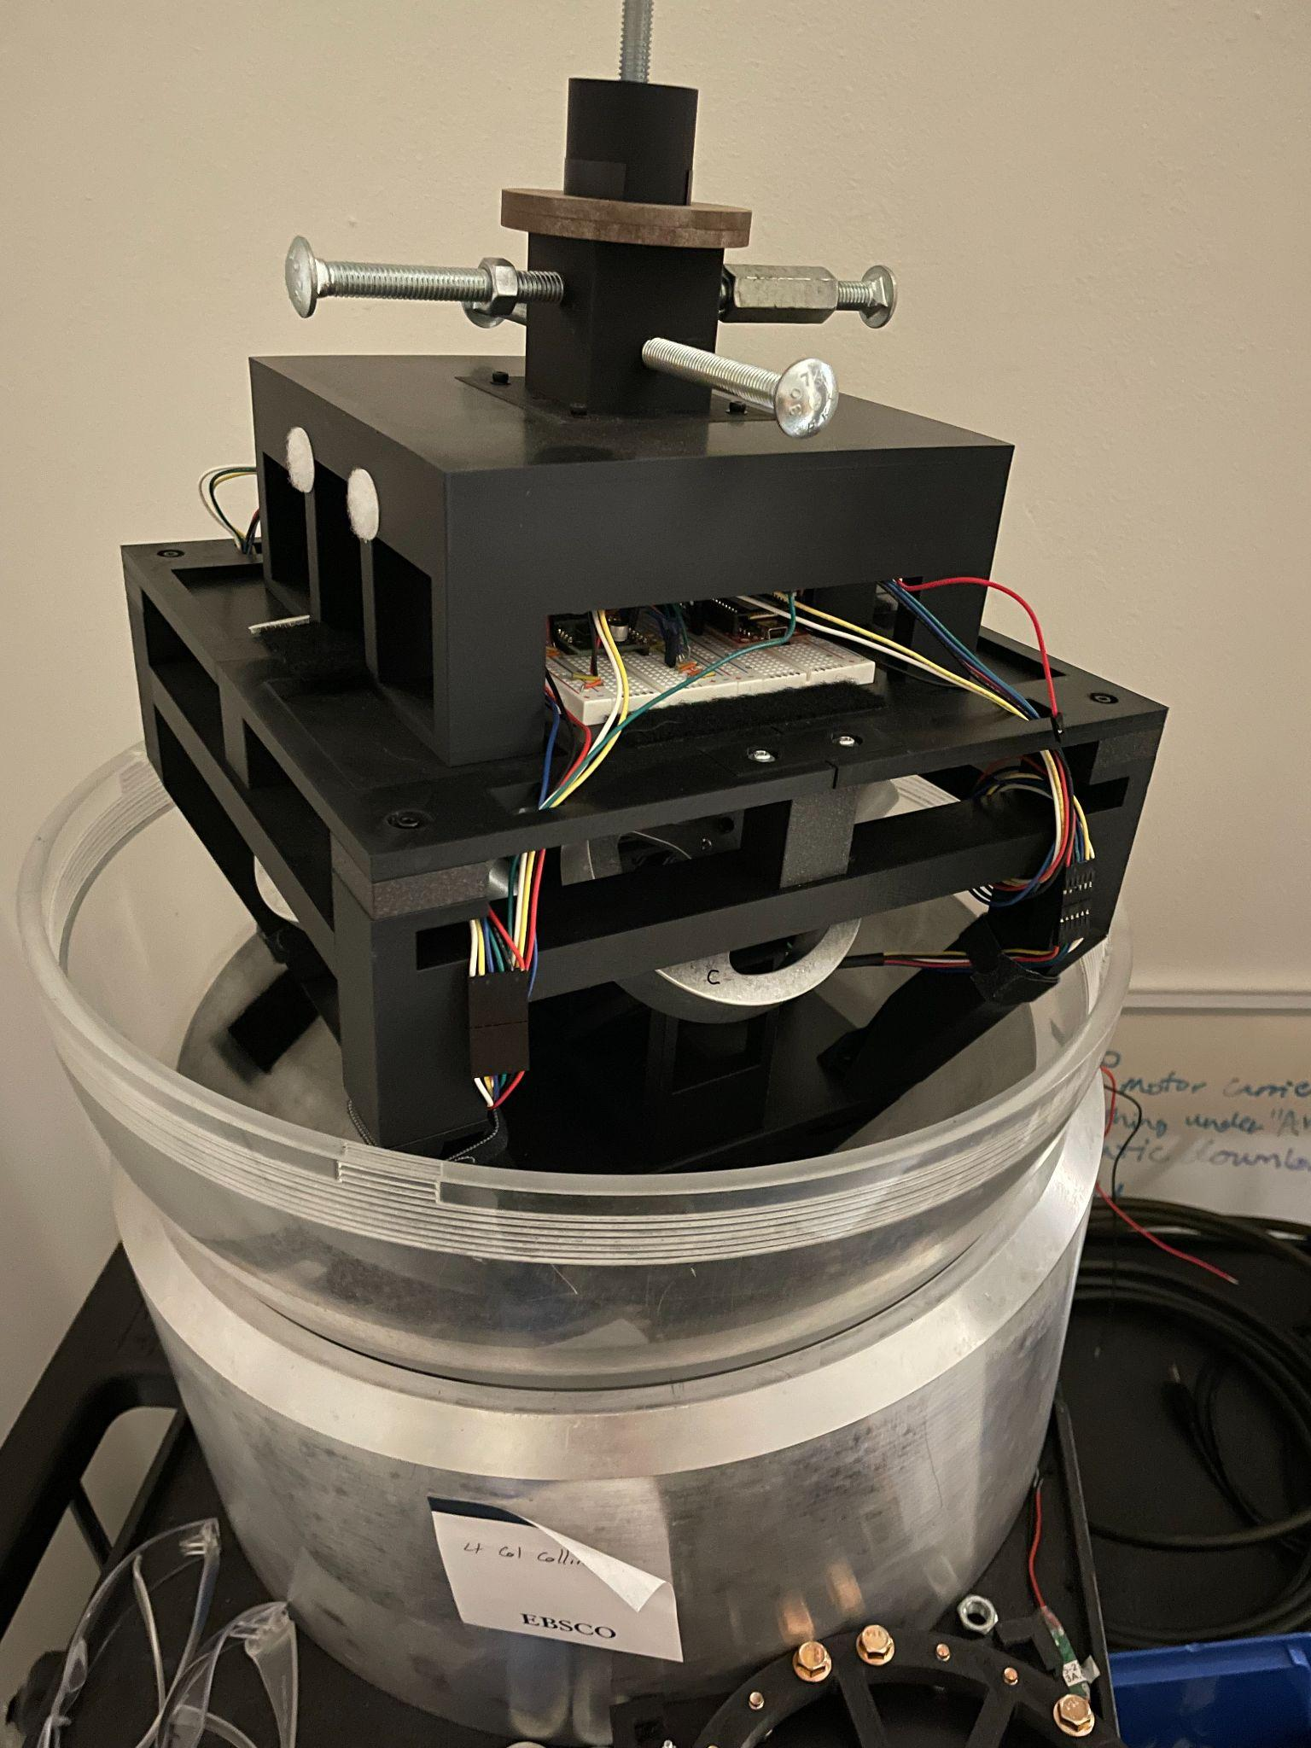
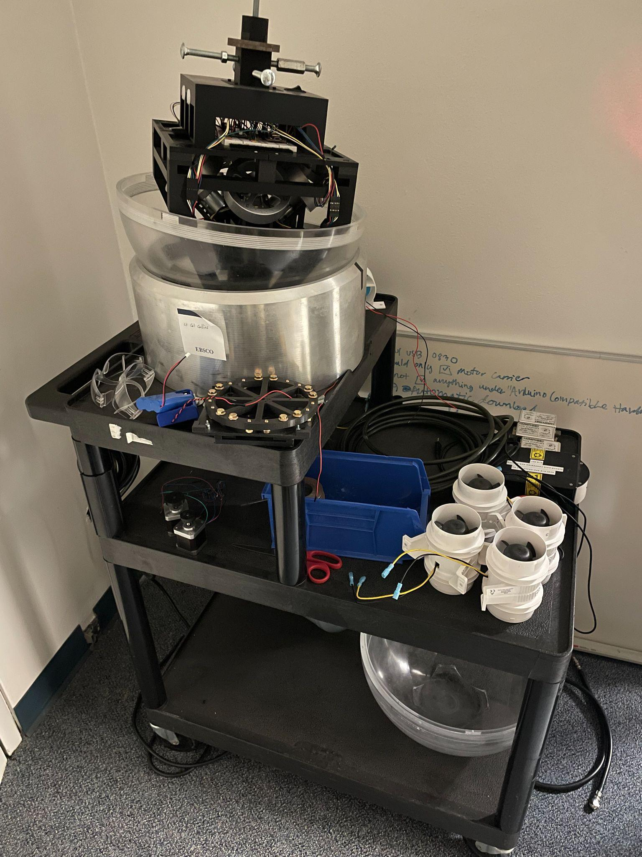
Overview/Objectives
Using the small air bearing table, develop a 3 degrees of freedom (3DoF) reaction wheel attitude control system.
Develop a robust sensor fusion algorithm using gyroscopes, magnetometers and accelerometers to accurately determine attitude at any given state.

Slide 3
Why Attitude Control Matters
1
2
3
POINT
KNOW
SURVIVE
Antennas, solar arrays and cameras only work when aimed. Reaction wheels give fine, continuous torque with no propellant.
You can only point what you can measure. Sensor fusion turns noisy gyros, accelerometers and magnetometers into one attitude estimate.
Wheels wear out: Kepler lost 2 of its 4 wheels by 2013 and its primary mission ended. A wheel failure must not end ours.
Req. 1: hold a heading
Req. 2: attitude to ±1°
Req. 3: detect + compensate
Why an air bearing: the table floats on air, so it can rotate in roll, pitch and yaw with almost no friction. The full sense → estimate → control → actuate loop can be tested on the ground, as it would run in orbit.
Notes:
Every spacecraft job depends on pointing: comms antennas at the ground, solar arrays at the sun, payloads at the target. If we cannot measure attitude, we cannot point; and wheels are the parts that wear out (Kepler). Our three requirements map one-to-one onto these jobs. The air bearing lets us test the whole loop on the ground: it removes friction and lets the table rotate freely in all three axes.

Slide 4
Requirements: Verification & Status
Requirement | Pass criterion | Status
(1) Hold a heading, no visible jitter or drift | Free table holds the commanded heading 1 min, |error| < 1° | ◐ Partial: DEMO LEVEL held heading ±0.5°; hold time limited by balance
(2) Know attitude to ±1° in all 3 axes | Estimate vs truth over the run, error < 1° | ◐ Roll/pitch σ 0.02°. Yaw with the magnetometer aid: within ±1° on 36/37 steps (worst 1.02°), 57 min, fixed table
(3) Detect a wheel failure and compensate | Kill a motor mid-maneuver: flagged < 1 s, then (1) and (2) still met | ◐ Built + simulated 9/9 PASS (detected in 0.6–0.8 s); table test next
Stretch: 4-attitude optimal slew | Each attitude reached on the shortest path and held 5 s within ±1° | ◐ Simulated 4/4 PASS on a balanced table; table needs CG raised ≈ 4.4 mm
✔ verified on hardware ◐ built / simulated, or met in part ○ not started
Notes:
Requirement 2: roll and pitch are far inside the limit. Yaw with the magnetometer aid passed 36 of 37 graded steps of MAG TEST on the fixed table; the one miss was 1.02°, 0.02° over. Replaying the same log showed why (each new wheel pattern was learned at the current yaw error) and that predicting those references instead passes 37/37, worst 0.77°: that firmware is built, not yet run on the table. Requirements 1 and 3 have working firmware and simulations; the remaining risk is table time and balance.

Slide 5
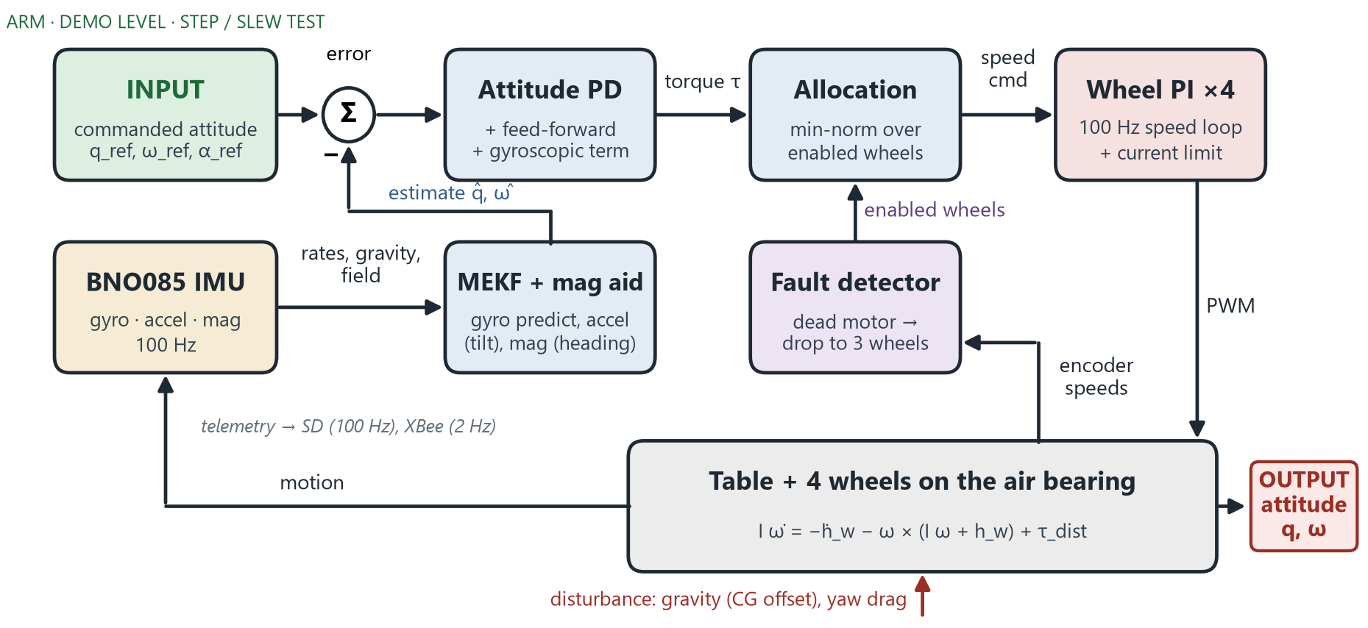
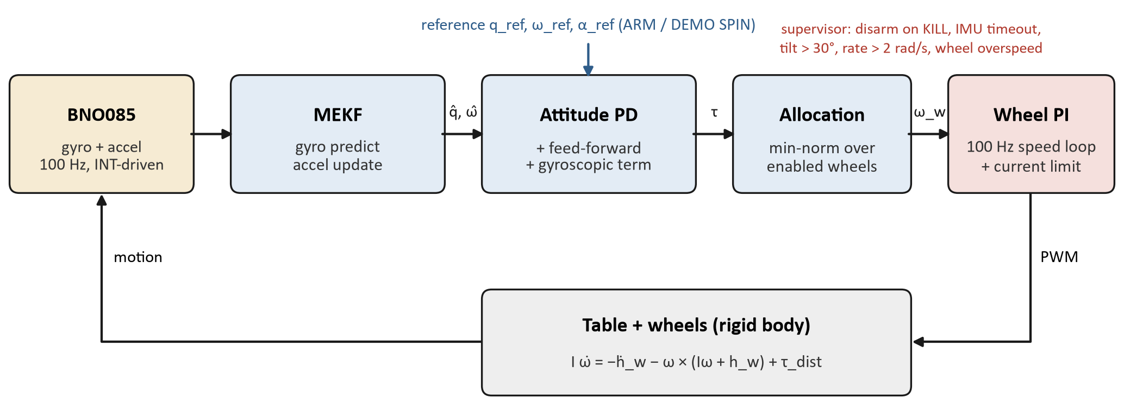
Theory: Estimation & Control Loop
Input: commanded attitude and rate from the active mode (ARM, DEMO LEVEL, STEP / SLEW TEST). Output: the table’s attitude.
Estimator: 6-state MEKF. Gyro predicts at 100 Hz; accelerometer corrects roll/pitch; magnetometer corrects heading when the wheels are in a known state.
Disturbances: gravity from the CG offset and air drag; wheels can’t dump momentum, so these set the hold time.

Slide 6
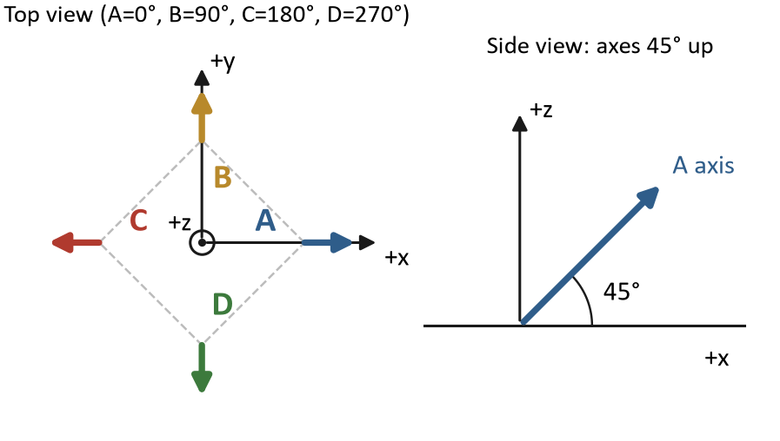
Theory: Control Law & Wheel Allocation
Quaternion PD with feed-forward:
τ = −Kp θₑ − Kd (ω − ω_ref) + I α_ref + ω × (Iω + h_w)
Kp = I ωₙ², Kd = 2ζ I ωₙ (ref. Engr 341 2nd-order system, ωₙ = 2 rad/s, ζ = 0.9)
4 wheels in a 45° pyramid: any 3 still span all axes → the basis for wheel-failure tolerance (Req. 3)
Minimum-norm allocation u = −D⁺τ over the enabled wheels; the 4th-wheel null mode [+1, −1, +1, −1] holds a bias speed
Inner loop: 100 Hz wheel-speed PI with a back-EMF current limit (2.5 A, no current sensor)
Physics limit: wheels cannot dump momentum.
Wheel J = 3.06×10⁻⁴ kg·m² (CAD); table I ≈ 0.062 kg·m² (model)
Speed limit 60 rad/s → ≈ 24 mN·m·s per tilt axis
Notes:
I * alpha_ref is feed-forward: we know acceleration dynamics, so we just put it in control law instead of waiting for error to build up.
D⁺: pseudo-inverse of D, gives least wheel torque for desired body torque

Slide 7
Code: Heading Update (Estimation)
// attitude_ekf.cpp: heading-only mag update
Vec3 mI = A^T * magBody; // field, inertial
float alpha = atan2(ref x mI, ref . mI);
// heading error
Vec3 h = A * ez; // H = [h^T, 0]
float S = h^T P h + sigma^2; // innovation var
K = P H^T / S; // Kalman gain
K[0..2] = (K . h) h; // rotate about
// vertical only
K[3] = K[4] = 0; // x/y bias: accel
q = exp(K[0..2]*alpha) (x) q; // multiplicative
b.z += K[5] * alpha; // z gyro bias
P = (I-KH) P (I-KH)^T + K R K^T; // Joseph
// mag_aid.cpp: only trust known wheel states
if (slow or reversing wheel) return GATED;
ref = stopped ? stopped_ : spin_[pattern];
Measurement: direction of the horizontal field vs a reference learned in place → heading error α
H = [(Aẑ)ᵀ 0]: only a turn about vertical changes the heading
K = PHᵀ/(HPHᵀ+R): σ sets a ≈ 25 s correction, so the gyro still carries fast motion
Gain edit: a disturbed field can never tilt roll/pitch
Bias: heading makes the z-gyro bias observable; gravity can’t
Gating: only known wheel states (stopped where learned, or spinning)
Prediction: a new wheel pattern’s reference comes from a known one, so yaw errors can’t pile up (MAG TEST)
Excerpts, simplified from attitude_ekf.cpp and mag_aid.cpp
Notes:
This is the magnetometer update we added after the prelim. The key design choice is the gain edit: the filter is only allowed to rotate the estimate about vertical, so a bad magnetic sample can never tip roll or pitch. The aid decides when the field can be trusted at all: the wheels must be in a known state.

Slide 8
Code: Control Law & Wheel Allocation
// attitude_ctrl.cpp: quaternion PD + FF
Quat qe = q (x) conj(q_ref); // attitude error
Vec3 th = -2 * vec(qe); // error angle
tau = -Kp*th - Kd*(w - w_ref) // PD
+ I*a_ref // feed-forward
+ w x (I*w + h_wheels); // gyroscopic
// wheel_geometry.h: min-norm allocation
M = sum(a_i a_i^T) // enabled only
y = inverse(M) * tau;
u_i = -(a_i . y); // wheel torques
// null mode n = [+1,-1,+1,-1]: no body torque
u_i += J * k * (bias - s_null) * n_i;
τ = −Kp θe − Kd(ω − ω_ref) + Iα_ref + ω × (Iω + h_w)
Kp = Iωn², Kd = 2ζIωn: ωn = 2 rad/s, ζ = 0.9 → about 1.5 s rise, no overshoot
u = −D⁺τ: least total wheel torque; any 3 of the 4 pyramid wheels still span all 3 axes (Req. 3)
Null mode: keeps every wheel ≥ 100 rpm from zero, so the magnetometer aid stays usable during holds
Tunable live: SET ATT_BW / ATT_ZETA / IZZ over the radio
Excerpts, simplified from attitude_ctrl.cpp, wheel_geometry.h, null_bias.cpp
Notes:
The control law is one line of code per term of the equation on the theory slide. Allocation is a pseudo-inverse over whichever wheels are enabled, which is why losing one wheel needs no new code path. The null mode spins the wheels against each other with zero net torque: we use it to keep every wheel away from zero speed for the magnetometer.

Slide 9
Code: Wheel-Failure Detection
// wheel_fault.cpp: every 0.1 s, per wheel
effort = duty - speed / 160; // ~ I / I_stall
if (|mean(effort)| >= 0.2) { // driven hard
predicted = 800 * sum(effort * dt);
// rad/s to gain
gained = (speed - speed0) * sign(effort);
bad = gained < 0.25 * |predicted|;
}
if (bad for 0.2 s) { // 2 blocks
wheelEnabled[i] = false; // use 3 wheels
wheels[i].coast(); // zero current
}
DC motor: current ∝ V − kₑω, so effort = duty − ω/ω_free estimates it without a current sensor
Healthy: J ω̇ ∝ effort → a predicted speed gain; a dead motor gains ~0
Coast, not brake: braking would dump the wheel’s momentum into the table
FAULT TEST: cuts a motor without telling the controller; graded on the Teensy
Excerpt, simplified from wheel_fault.cpp
0.6–0.8 s
0
to detect a dead motor (simulation)
false alarms in 4 healthy simulated runs
Notes:
There is no current sensor, so we infer motor current from the duty cycle and the back-EMF. A healthy motor that is pushed hard must speed up; a dead one does not. Two bad 0.1 s blocks in a row and the wheel is taken out of the allocation. It coasts instead of braking, because braking a spinning wheel would dump its momentum into the table.

Slide 10
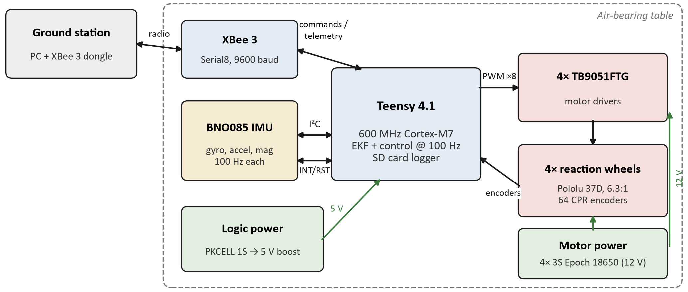
Build Progress: Hardware
Power system: separate 5V logic pack, one 12 V pack per wheel, low-side motor switch, star ground, bench wiring sheet
Verified on the table: pin map and encoder wiring corrected, wheel/encoder signs set; gearboxes found to be 6.3:1, not 10:1 (hand-turn encoder counts)
Added IMU data-ready (INT) and reset (RST) wires → reliable data at 100 Hz

Slide 11
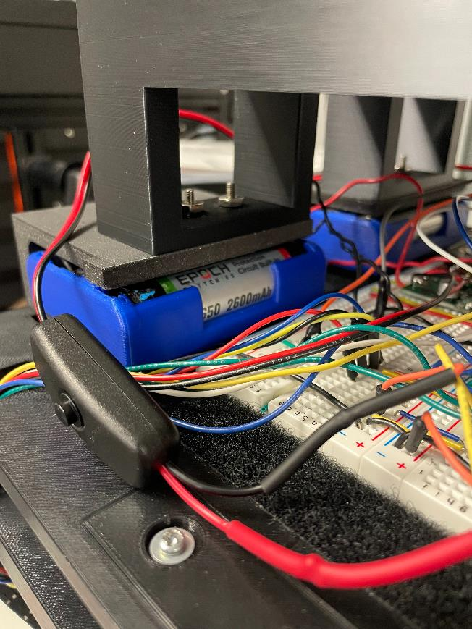
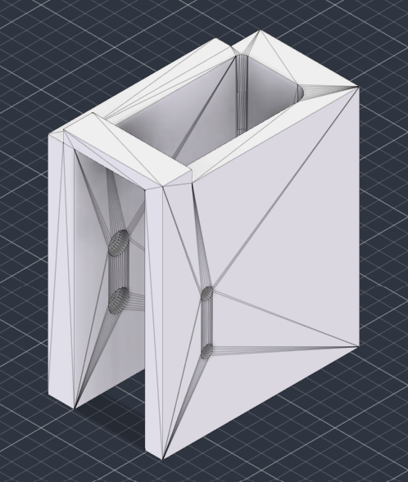
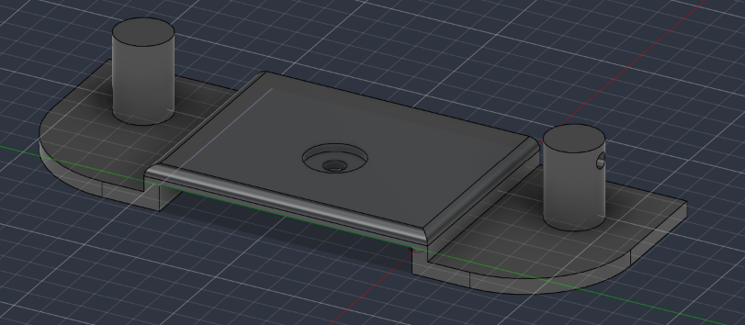
Build Progress: Hardware
Washer Holder CAD
Battery Holder Detail
Battery Holder CAD

Slide 12
Progress: Software Build & Tests
Date | Test | Key result
10-08 | Wheel spin direction | Wiring corrected, signs set
10-15 | Bench speed sweeps, hand-turn counts | 6.3:1 gearing; wheel A rubs
10-15 | Static IMU test (37 min) | Roll/pitch 0.02°; yaw drift 27 °/h
10-16 | MAG MAP; first DEMO SPIN | Wheels disturb the magnetometer; table is a pendulum
10-20 | IMU INT/RST + SD fixes | Sample loss 25% → 0.085%
10-21 | Balance weights; DEMO LEVEL | Swing 1.8 → 3.3 s; level held up to 15.8 s
10-27 | Magnetometer calibration + aid | Wheel field model; aid works with wheels stopped
10-29 | Aid spinning test; SLEW / FAULT sims | ±0.94° spinning (2 wheels); sims 4/4 and 9/9 PASS
10-29 | Flight computer failure | 3.3 V rail shorted inside the Teensy → spare
10-30 | Spare bring-up; wheel re-test | All 4 wheels 44–47 rad/s at 0.3 duty
10-30 | MAG MAP (4 wheels); MAG TEST | New wheel model; yaw within ±1° on 36/37 steps (worst 1.02°)
Teensy software (C++, PlatformIO): MEKF + magnetometer aid, attitude controller, allocation, wheel loops, fault detector, safety supervisor, 100 Hz SD log + XBee link, scripted tests run and graded on board (DEMO LEVEL, MAG TEST, STEP / SLEW / FAULT TEST), live tuning (SET / GET).

Slide 13
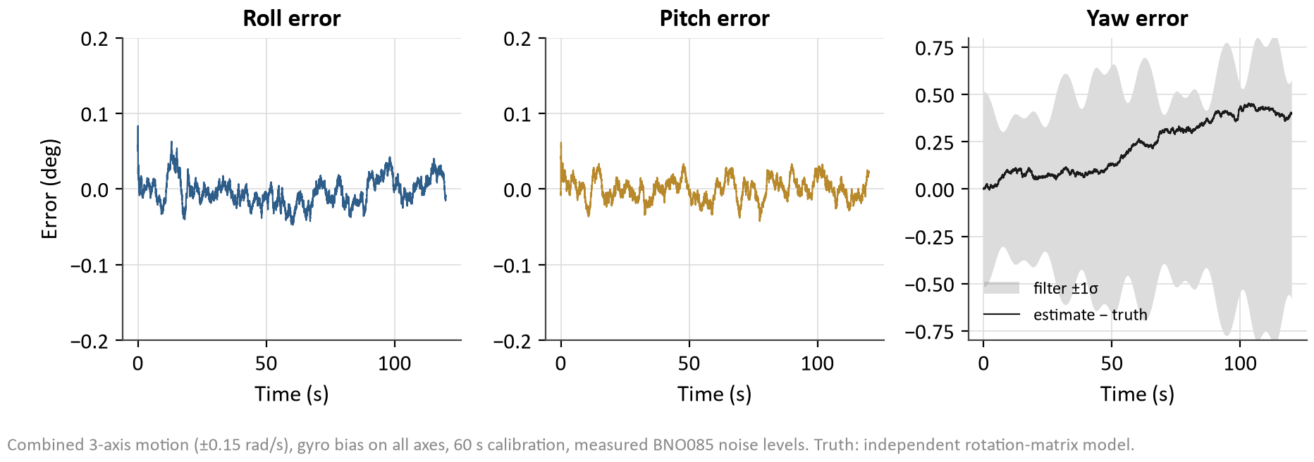
Simulation: Methods
Truth model (independent)
Firmware logic (ported)
Test cases
Rigid table + 4 wheels, gyroscopic coupling
Motors: stall torque, back-EMF, friction, pack differences
Encoder counts, gyro noise
Gravity pendulum + yaw drag fitted to the table
MEKF and magnetometer gating
Quaternion PD, allocation, null mode
100 Hz wheel PI with current limit
Fault detector and the on-board test graders
Balanced vs today’s pendulous table
Each wheel failing; mid-slew and mid-hold
Healthy runs to count false alarms
Pass/fail by the same rules as on the table
Takeaway: Estimator vs truth (3-axis motion): roll/pitch error < 0.1°, yaw inside its 1σ band
Notes:
We simulate before every table session: table time is scarce, and a bad controller can throw the satellite off the bearing. The truth model is written separately from the firmware, so the two can disagree. That is how we caught real bugs. The estimator check below is the first thing we ran.

Slide 14
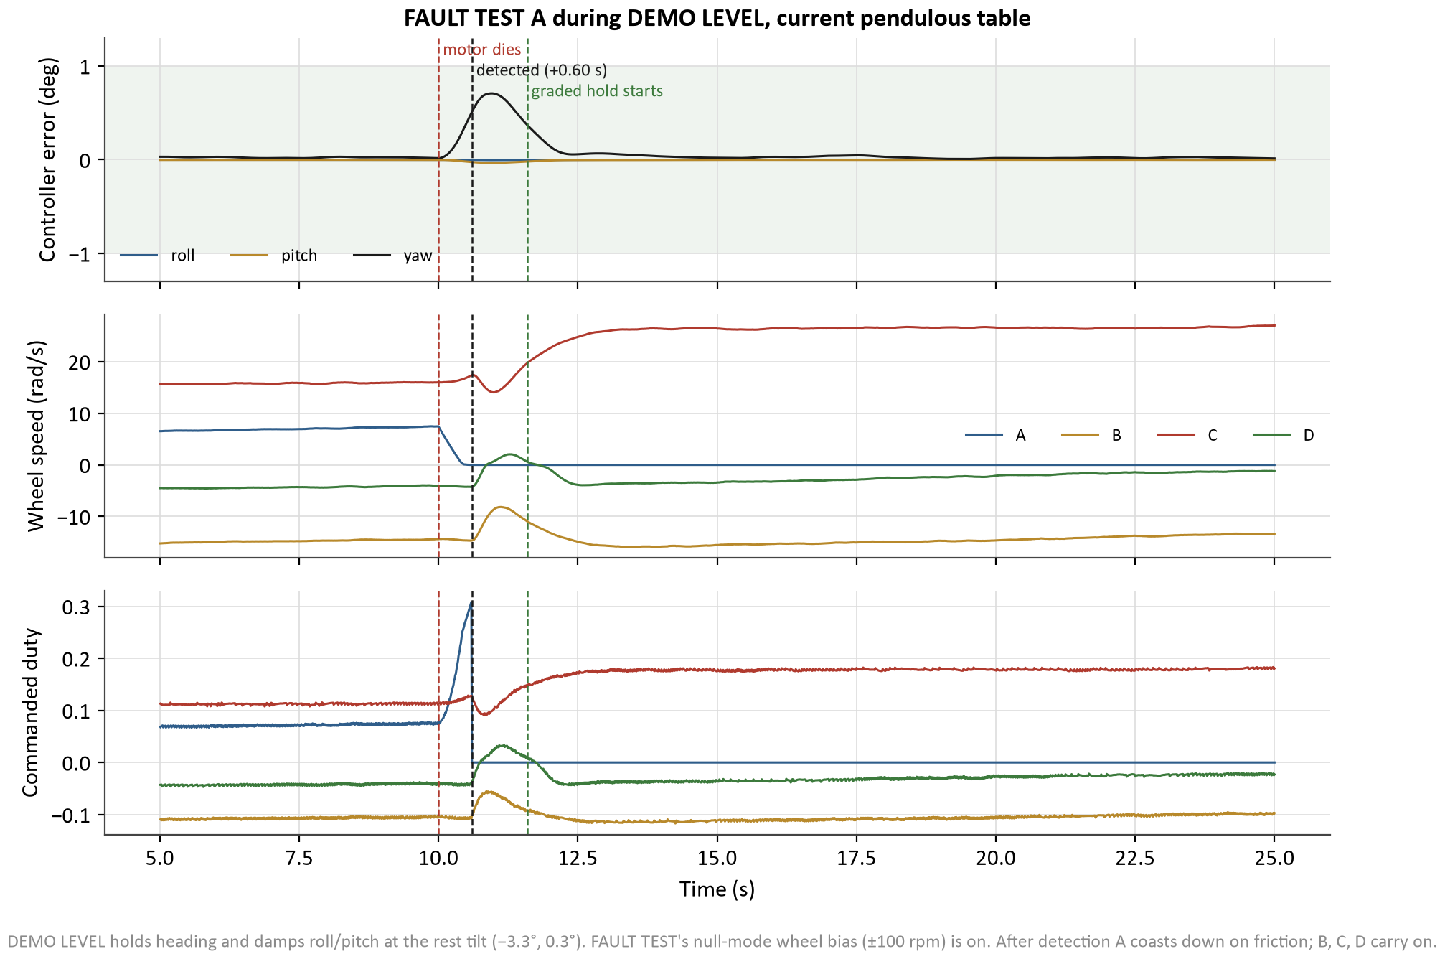
Simulation: Wheel Failure (Req. 3)
Takeaway: A motor dying mid-hold is caught in < 1 s and the other 3 wheels hold ±1°
9 / 9
graded runs PASS
0.6–0.8 s
to detect the dead motor
≤ 1.0°
peak error while recovering
0
false alarms in 4 healthy runs
Notes:
This is FAULT TEST in simulation. Wheel A dies 10 s into a level hold on today’s pendulous table. The detector flags it 0.6 s later, the wheel coasts down, and B, C and D take over. The peak error stays inside ±1°. We ran every wheel, failures mid-slew and mid-hold, and an unplugged motor: 9 of 9 pass.

Slide 15
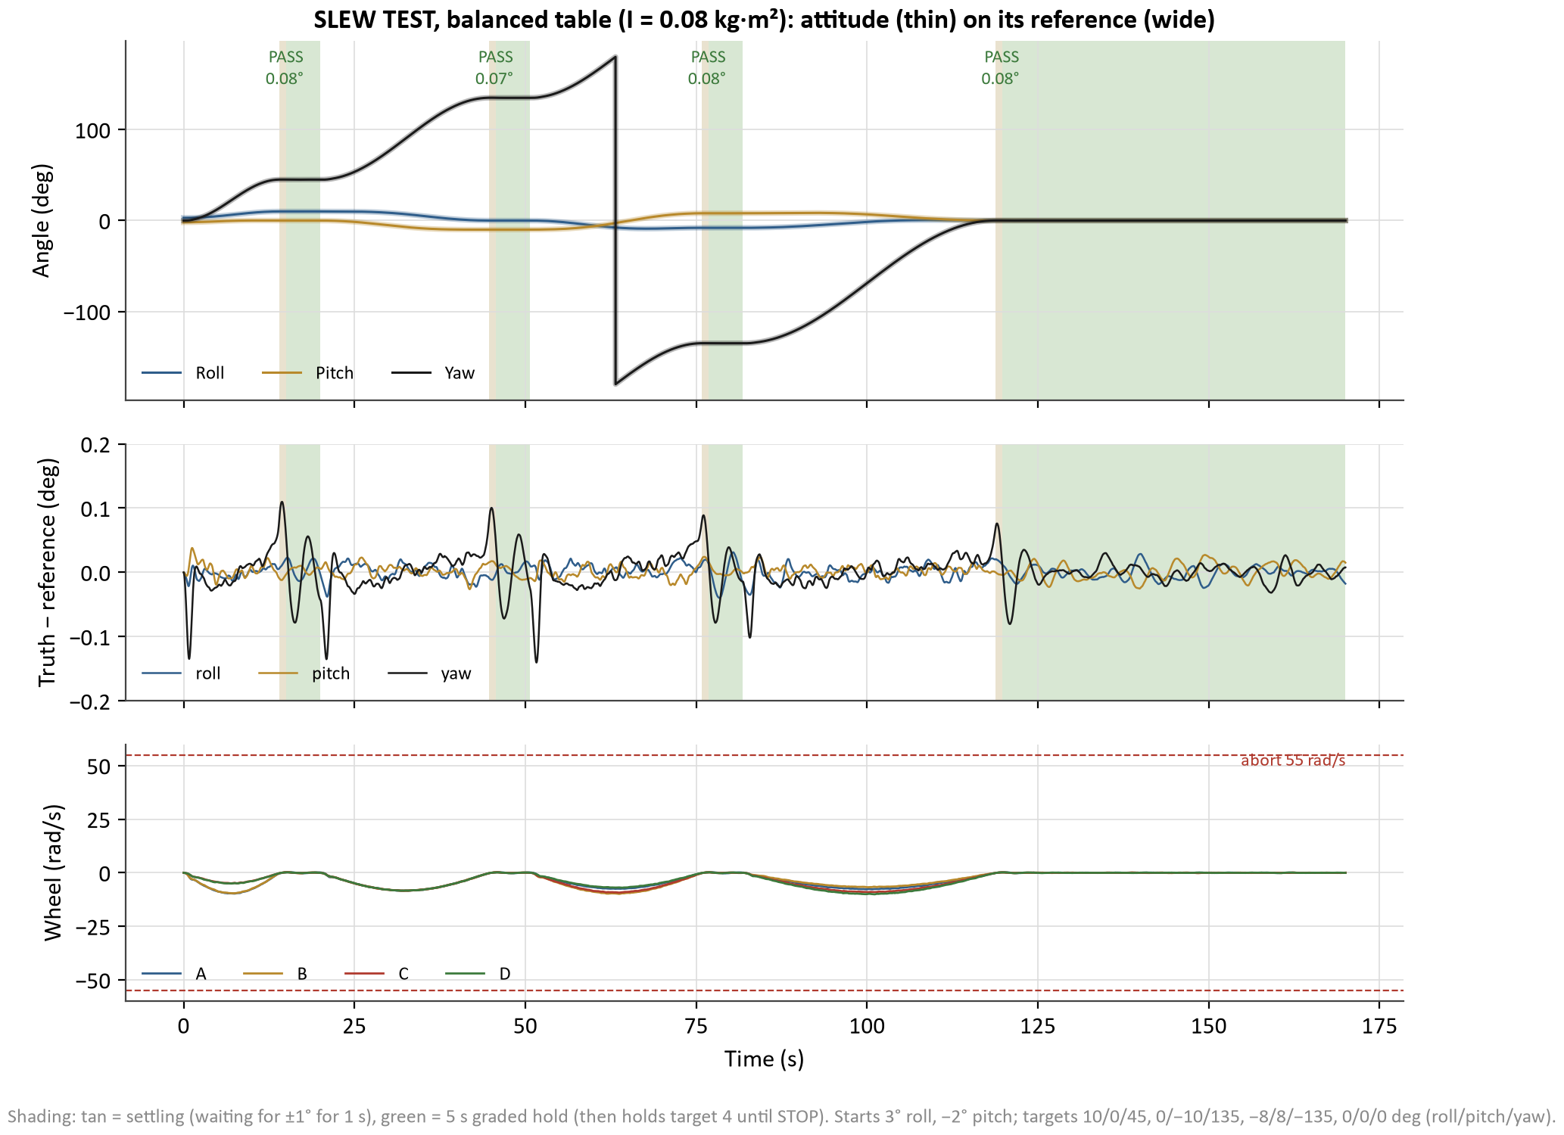
Simulation: 4-Attitude Slew (Stretch)
Takeaway: The slew logic meets ±1° on a balanced table; today’s balance is the blocker
4 / 4
targets PASS, balanced table (max err 0.08°)
4.9 s
until a wheel saturates on today’s table
≥ 55 s
swing period needed (today 3.3 s)
4 / 4
yaw-only targets pass at today’s rest tilt
Notes:
SLEW TEST: four targets, shortest-rotation slews on a smooth profile, then a 5 s hold graded at ±1°. On a balanced table all four pass with under a tenth of a degree of error. On today’s table, gravity torque saturates a wheel 4.9 s into the first tilted slew. So the stretch goal is now a balance problem, not a software one.

Slide 16
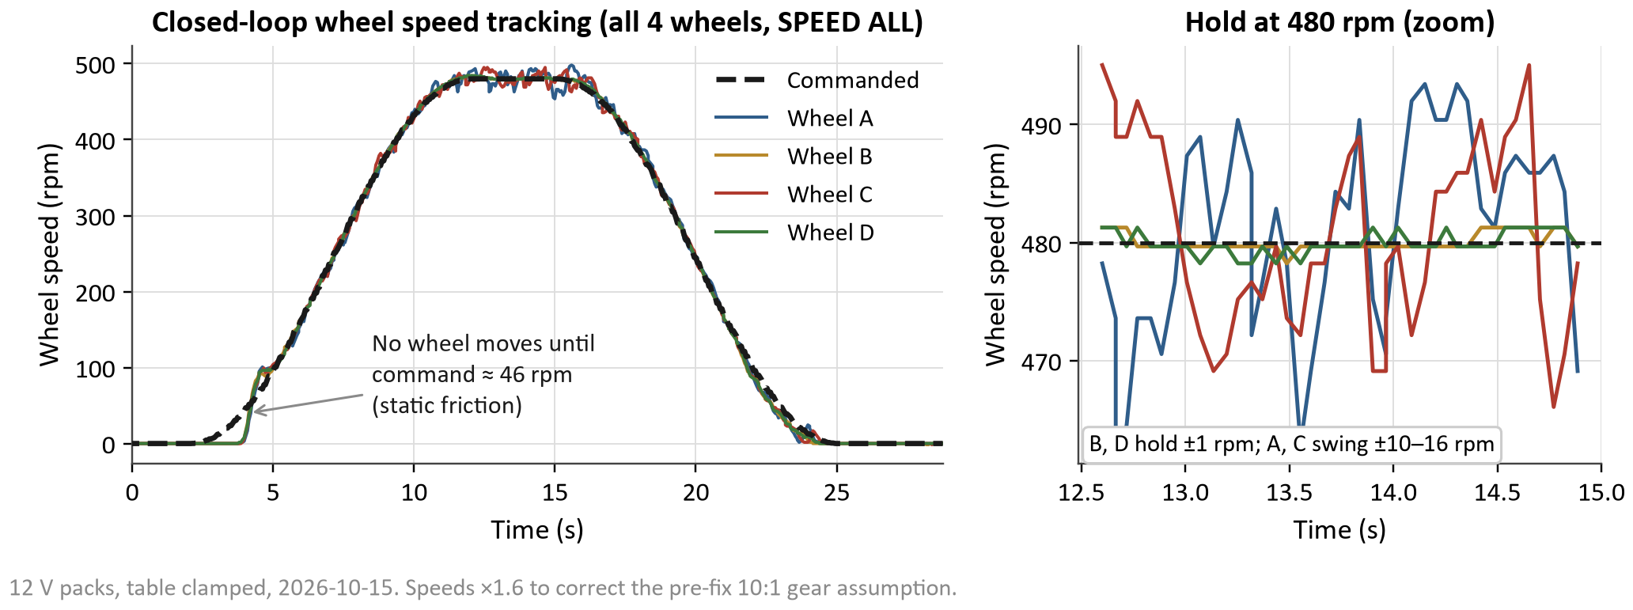
Data: Wheel Speed Control
Takeaway: B and D track within ±1 rpm; A and C errors come from hardware, not the control loop
MEASURE: Commanded vs measured speed, all 4 wheels, 0 → 480 → 0 rpm (12 V packs).
COMPARE: Tight tracking expected from the 100 Hz PI + feed-forward; same gains on every wheel.
EXPLAIN: A rubs and C oscillates (±10–16 rpm); nothing turns below ≈ 46 rpm (static friction).
NEXT: Fix A’s rub; add static-friction compensation; repeat.

Slide 17
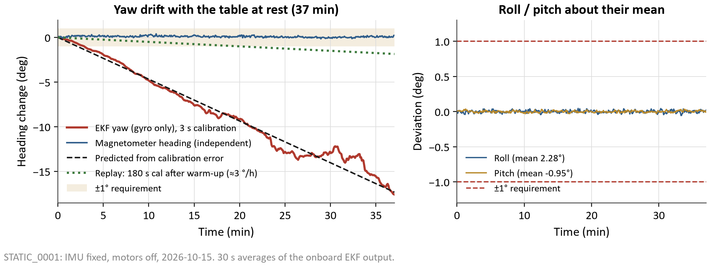
Data: Attitude Determination at Rest
Takeaway: Roll/pitch are 50× inside ±1°; the yaw drift was a calibration error, now fixed
MEASURE: 37 min, IMU fixed, motors off: EKF roll/pitch/yaw and the magnetometer heading.
COMPARE: Requirement ±1°. A 3 s gyro-bias average predicts ≈ 26 °/h of yaw drift.
EXPLAIN: Roll/pitch σ = 0.02°. Yaw drifted 27 °/h, as predicted. A 180 s calibration after a 10 min warm-up gives ≈ 3 °/h.
NEXT: Done: the magnetometer aid now holds yaw (MAG TEST).

Slide 18
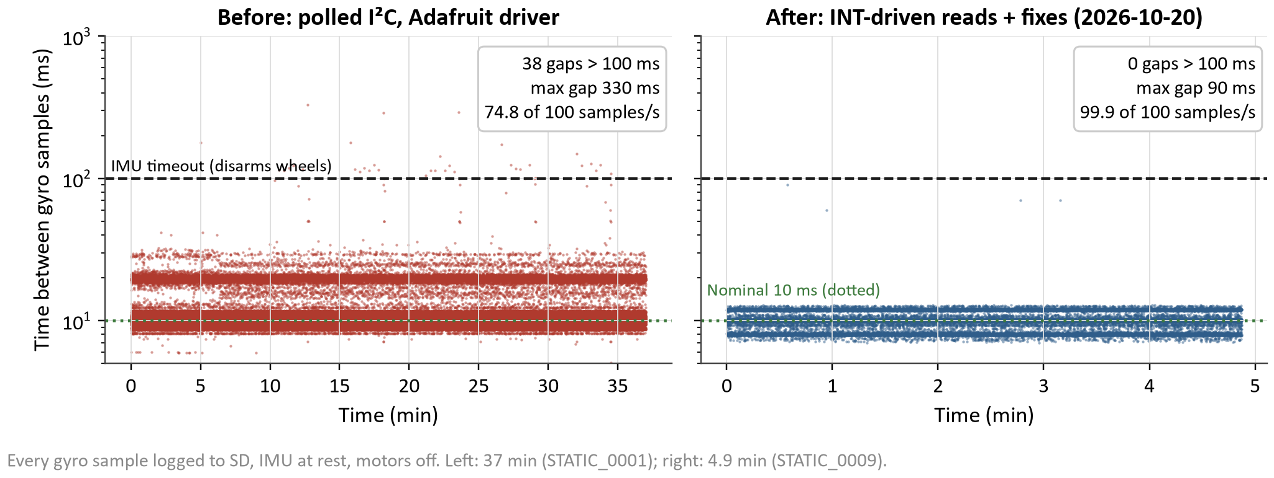
Data: IMU Data Integrity (Unexpected Result)
Takeaway: Lost samples cut from 25% to 0.085%: no more false IMU-timeout shutdowns
MEASURE: Time between gyro samples logged to SD, IMU at rest, before and after the fixes.
COMPARE: Expected 10 ms. Before: 25% lost, 38 gaps > 100 ms (each would have disarmed the wheels).
EXPLAIN: Library kept only the last report per read; SD writes blocked the loop. Fixed: INT/RST wires, IMU read during SD waits, SD DMA.
NEXT: Remaining 60–90 ms stalls are inside the BNO085, under the 100 ms timeout.

Slide 19
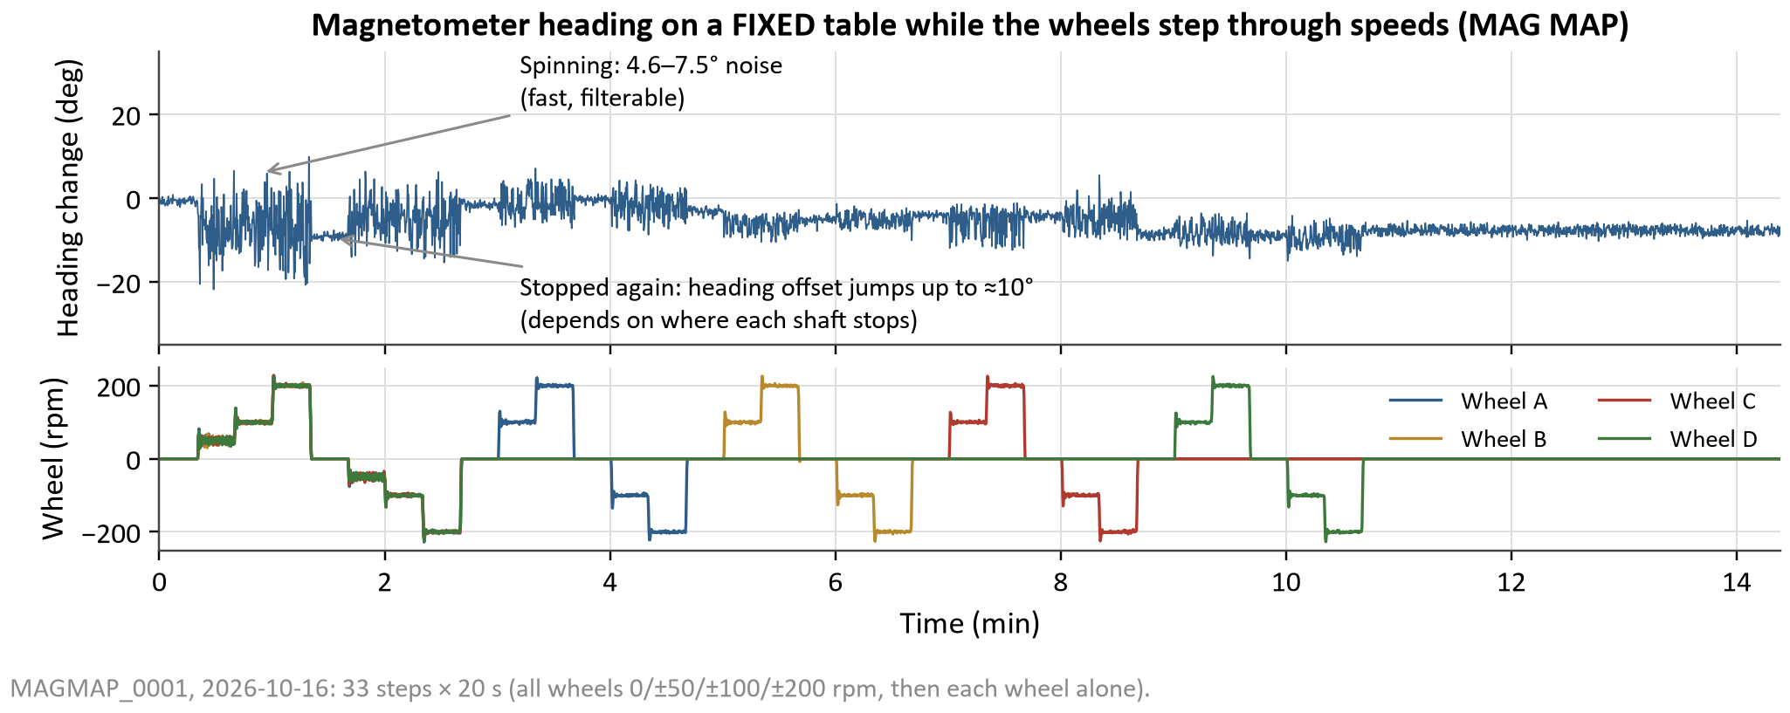
Data: Magnetometer vs. Wheel Motors
Takeaway: Spinning wheels add fast, filterable noise; stopped wheels leave random offsets
MEASURE: Raw magnetometer heading, fixed table, wheels stepped through ±50/100/200 rpm (MAG MAP).
COMPARE: A heading aid must be steady to well under 1°; motors off: 0.7° noise, no drift.
EXPLAIN: Spinning: 4.6–7.5° of fast noise (low-passed out). Stopped: offsets up to ±10°, set by where each shaft stops.
NEXT: Done: an aid that trusts only known wheel states (next slide).

Slide 20
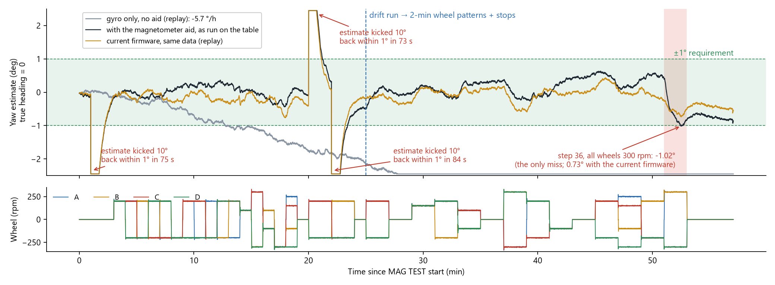
Data: Magnetometer Yaw Aid (MAG TEST)
Takeaway: Aid kept yaw within ±1° on 36/37 steps; gyro alone drifted 6 °/h
MEASURE: 37 graded steps, 57 min, fixed table: stopped, 14 wheel direction patterns, ±10° kicks, 30 min drift run; graded on the Teensy.
COMPARE: Requirement ±1° (the true heading is 0). Gyro alone (replay, aid off): 5.7 °/h even after warm-up.
EXPLAIN: 36/37 PASS; step 36 (all wheels 300 rpm) reached 1.02°. Cause: each new wheel pattern was learned at the current yaw error. Replayed with prediction: 37/37, worst 0.77°.
NEXT: Upload the predicting firmware; repeat on the floating table with the wheel bias; hard-iron fit before yaw slews.
Notes:
MAG TEST runs on the Teensy and grades itself. The table is clamped, so the true heading is zero and any yaw shown is estimation error. The wheels step through stopped, 14 direction patterns and three speeds; three times we deliberately rotate the estimate 10° to prove the aid pulls it back. Then 30 minutes of drift run. Grey is the same data replayed on the PC with the aid off: the gyro alone drifted almost 6 °/h even after warm-up. Black is what ran: one step, all wheels at 300 rpm, reached 1.02°. Gold is the same data through the current firmware, which predicts each new wheel pattern's reference instead of learning it at the current error: every step passes.

Slide 21
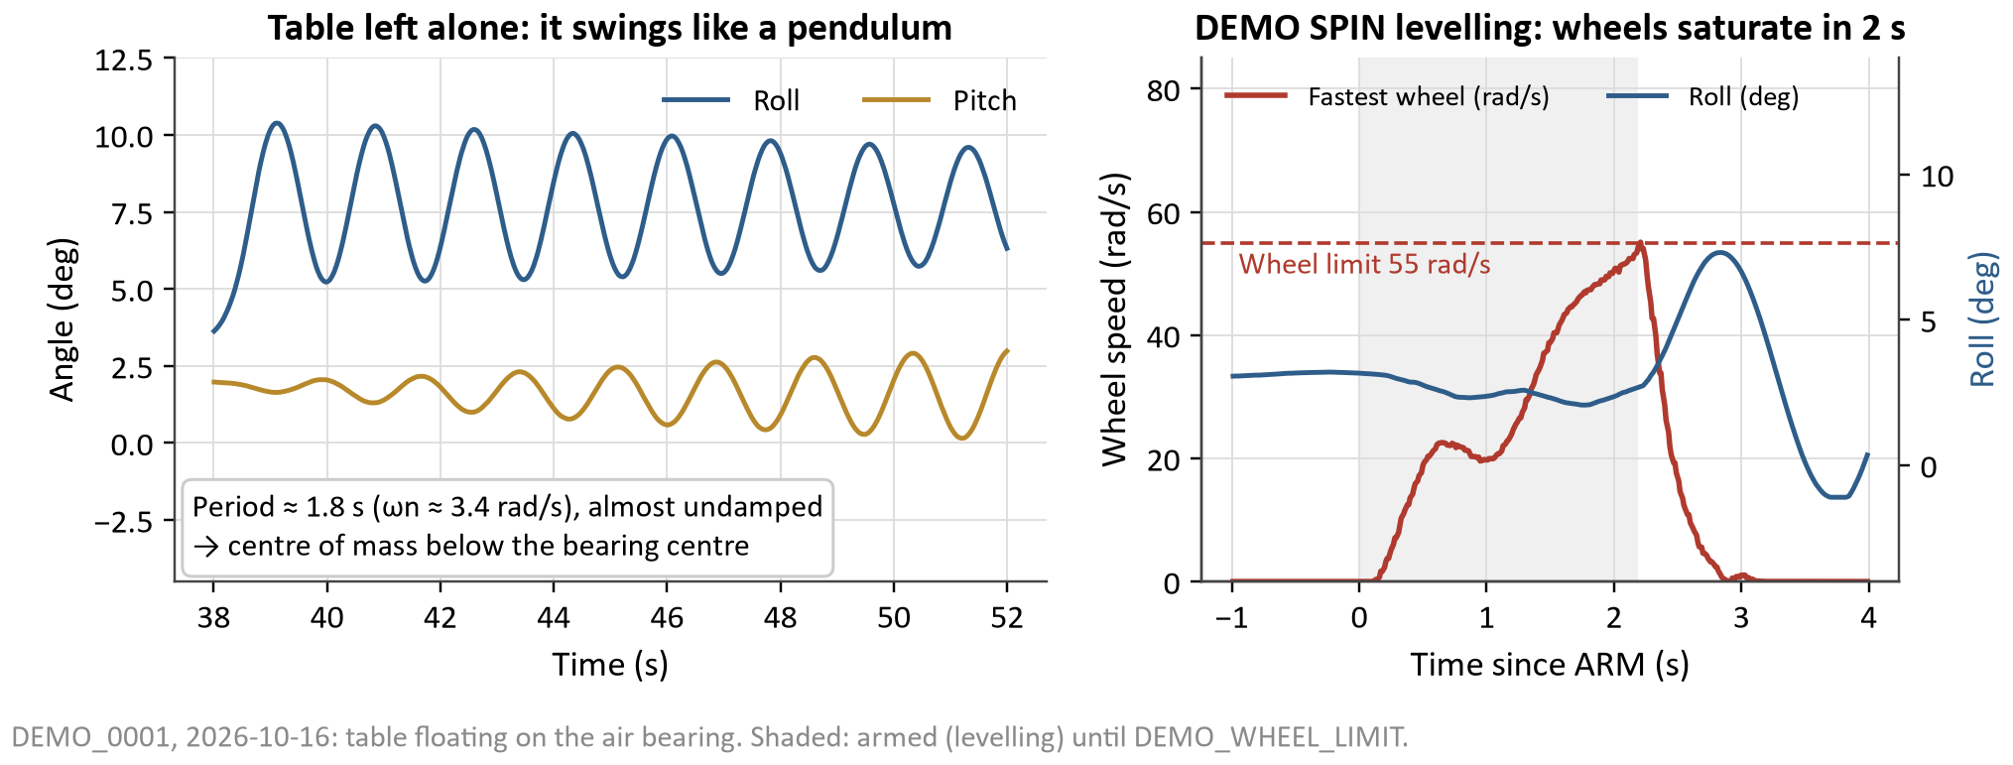
Data: First DEMO SPIN (Unsuccessful)
Takeaway: The table is a pendulum: gravity overwhelms the wheels within 1–2 s
MEASURE: Roll/pitch and wheel speeds, table floating; three DEMO SPIN attempts.
COMPARE: Simulation (CG at the bearing centre) levelled from 30° in ≈ 11 s; the table hit the wheel limit in 1–2 s.
EXPLAIN: 1.8 s swing, resting ≈ 3° off level: gravity ≈ 16 mN·m per degree vs ≈ 24 mN·m·s of wheel storage.
NEXT: Done: bottom weights and lateral trim (next slide).

Slide 22
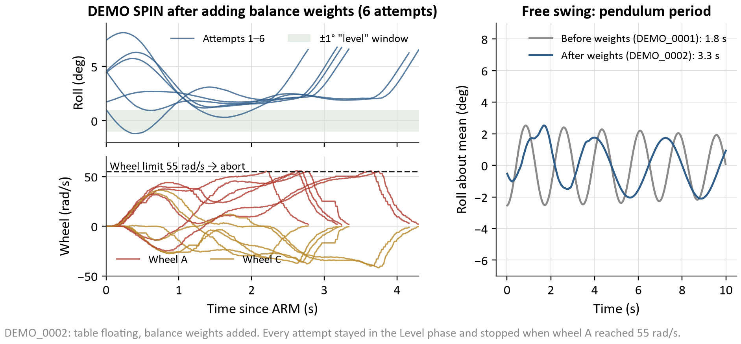
Data: DEMO SPIN Leveling
Takeaway: Weights made gravity’s pull 3× weaker and fixed pitch; roll still rested 3.3° off
MEASURE: Six DEMO SPIN attempts after adding weights: roll, wheel speeds, free swing.
COMPARE: Expected: level (< 1° for 3 s), then spin. Every attempt hit the wheel limit after 2.2–3.7 s.
EXPLAIN: Swing period 1.8 → 3.3 s; the −y side is heavy, so holding level fills wheel A in ≈ 3 s.
NEXT: Done: roll trim and DEMO LEVEL (results after the video).

Slide 23
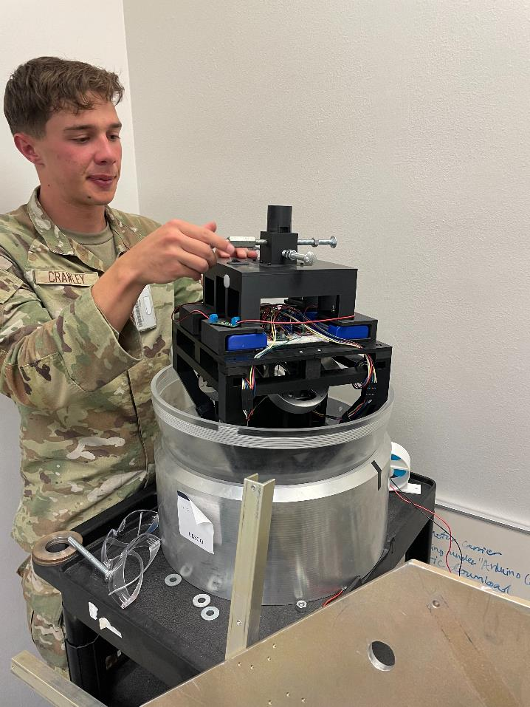
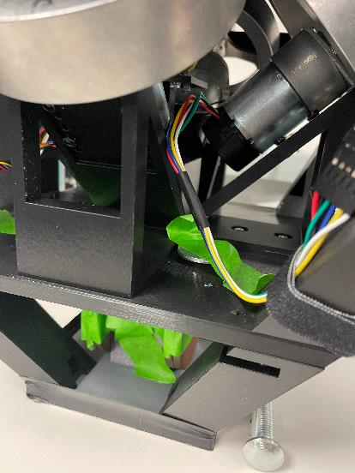
DEMO SPIN
Setting Up for Spin
Additional Weight Detail

Slide 24
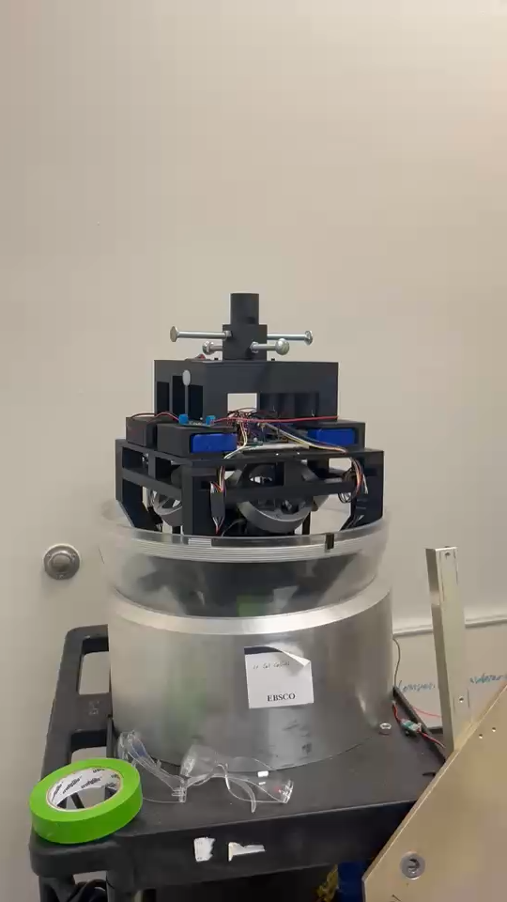
DEMO SPIN: Leveling Video

Slide 25
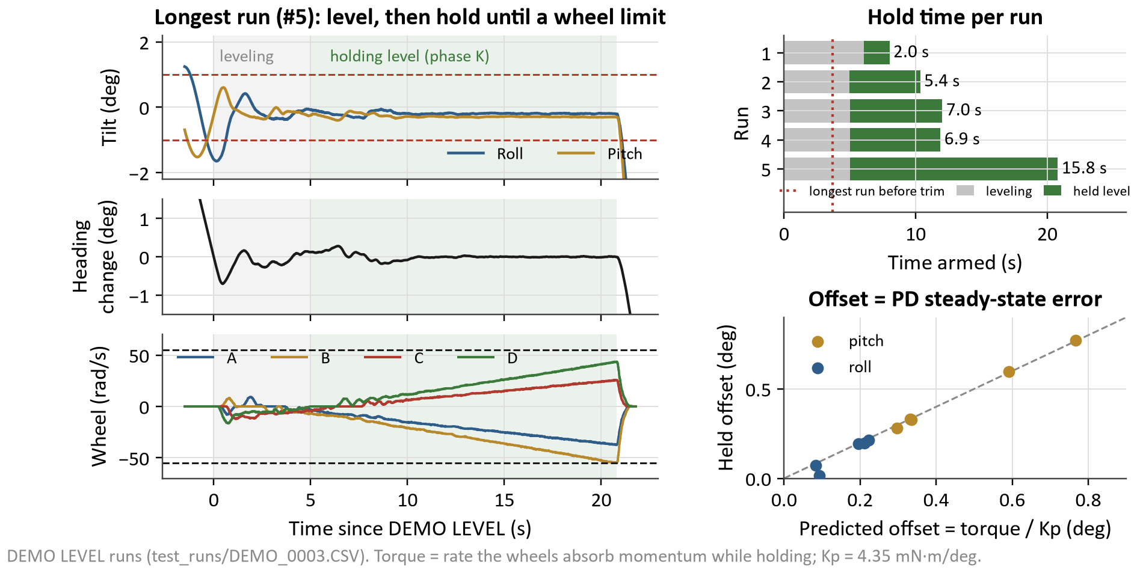
Data: DEMO LEVEL Hold
Takeaway: After the roll trim the table levels in 5–6 s and holds steady until gravity fills a wheel
MEASURE: Five DEMO LEVEL runs after the roll trim (DEMO_0003): level, then hold until a wheel limit.
COMPARE: Hold level without visible jitter; the limit is wheel momentum vs leftover gravity torque.
EXPLAIN: Held roll/pitch σ ≤ 0.07°, heading within 0.5°, for 2–15.8 s; leftover 1.3–3.3 mN·m fills wheel B. Offset = torque / Kp (right).
NEXT: DEMO LEVEL now holds the natural rest tilt (no steady torque); raise the CG ≈ 4.4 mm for the slews.
Notes:
After the roll trim, DEMO LEVEL levels the table and holds it. Each run ends when gravity has filled a wheel. The right panel is the proof that the leftover tilt is the controller’s expected steady-state error, torque over Kp, and not a sensor problem.

Slide 26
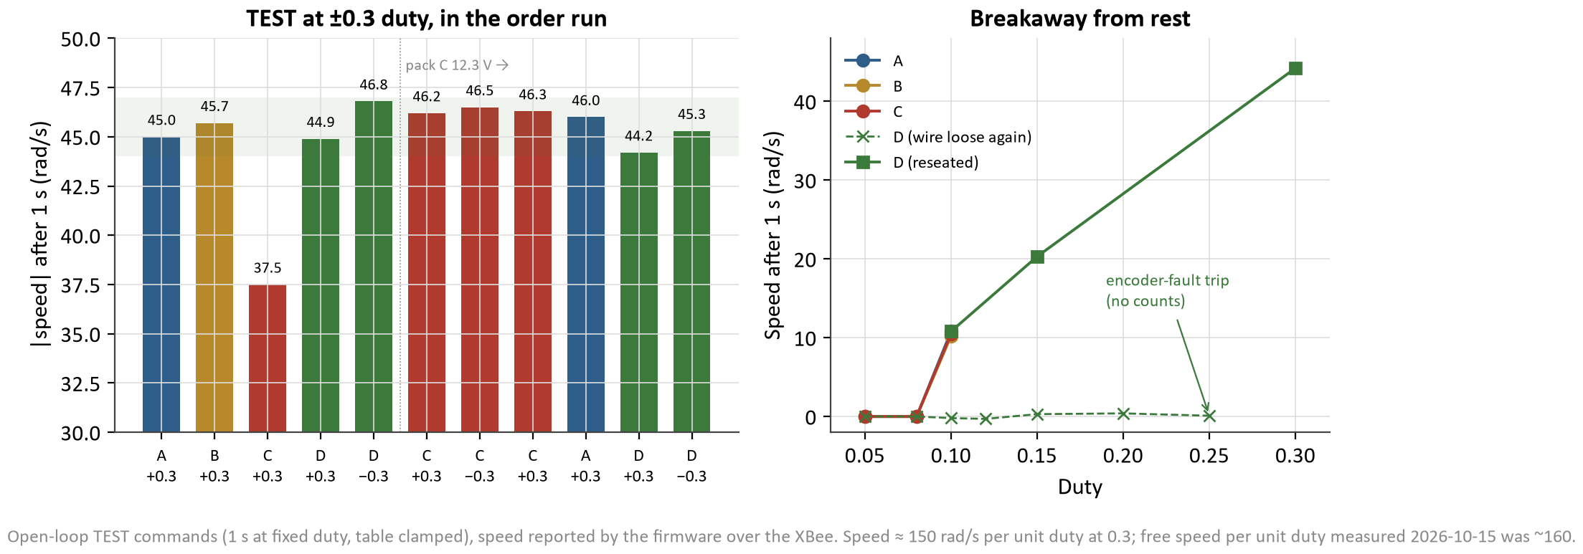
Data: Flight Computer Failure (Unexpected)
Takeaway: Teensy’s 3.3 V rail shorted; spare brought up, all 4 wheels re-verified in a day
MEASURE: Board dead after test 5 (no USB, no 3.3 V); then the spare, wheels re-tested at ±0.3 duty and from rest.
COMPARE: Expected ≈ 45 rad/s at 0.3 duty and breakaway at 0.08–0.10 duty on every wheel.
EXPLAIN: Old board’s 3.3 V rail: 0.8 Ω and hot, so it was shorted on the board; no wiring cause found. Wheels 44–47 rad/s; D’s encoder wire was loose.
NEXT: Solder wheel D’s lead; separate the spare’s VIN–VUSB pads (until then, never USB and battery together).
Notes:
After the first spinning magnetometer test the Teensy went dark. We traced it to a short on its own 3.3 V rail, then brought a spare up one stage at a time, checking voltage and heat at each step. Then we re-ran the motor checks: every wheel back at about 45 rad/s, and wheel D’s missing data turned out to be a loose encoder wire.

Slide 27
Future Plans: Where We Stand
Complete
Needs improvement
Remaining
Attitude estimator: roll/pitch 0.02°
Magnetometer yaw aid, 55 min graded test
Reliable 100 Hz IMU data
Wheel loops, all 4 wheels
Fault detection + 3-wheel control (simulated)
SLEW / FAULT / STEP tests on board
Spare flight computer up
Balance: CG ≈ 4.4 mm below the bearing centre
Yaw aid: 36/37 steps as run; fix replays 37/37
Hold time: gravity + yaw drag fill the wheels
Wheel A rub; wheel D encoder lead
Real inertia (STEP TEST ready)
Heading hold on the free table (Req. 1)
Yaw accuracy on the floating table (Req. 2)
Wheel-failure test on the table (Req. 3)
Stretch: 4-attitude slew (needs balance)

Slide 28
Future Plans: Path to the Final Demo
# | Next task | Verifies | Needs
1 | Upload; LEVEL ZERO (IMU mount) and STEP TEST (inertia, gains) | Req. 1, 2 | Table time
2 | DEMO LEVEL heading hold with the aid on vs off | Req. 1, 2 | —
3 | FAULT TEST on the floating table | Req. 3 | Solder wheel D lead
4 | Hard-iron fit from a full yaw turn | Req. 2 | —
5 | Raise CG ≈ 4.4 mm (balance tool), then SLEW TEST | Stretch | Trim mass
Key risks
Balance: tilted targets saturate the wheels until the CG is raised
Yaw drag fills the wheels in ≈ 6 min (no momentum dumping)
Wheel D encoder lead; spare board’s USB/battery limit
Improvements beyond KestrelSAT
Use of the air bearing table
Magnetometer aid that works with spinning wheels
Automatic wheel-failure detection
Tests that run and grade themselves on board
Notes:
Spoken Feedback: Good baseline for pres, enlarge requirements (symbology: checkmarks), practice brief before final pres, add in/out to control loop, self-sustaining plots (have them be able to tell their own story, note important points), have pics tell story as well, include code snips (parse out each section + theory), why does ADSC matter???
Written Feedback: Clean up readability of wordy slides. Add simulation methods/results. Add Input and output explicitly to closed loop system. Make sure to tell story with plots, independent of description. Show and discuss code snippets for various parts.

Slide 29
GenAI Use Documentation
Primary Tool: Claude Code, Opus Model
  Firmware: drafted the EKF and magnetometer aid, controller, allocation, fault detector, IMU driver, logger, command set and the self-grading tests, from the team’s requirements and design decisions; the team reviewed, uploaded and tested every build
  Simulation and analysis: wrote the truth models, the log-replay and balance tools and the plots; the team ran the tests and checked the conclusions
  Documentation: CLAUDE.md, TODO.md, PROGRESS_LOG.md, test reports and drafts of these slides
Team-owned: hardware build, wiring and power system, requirement and design decisions, test design, execution, and final review of every result
Full record of work: PROGRESS_LOG.md and the git history in the team repository

